Slide 1

Recommender Systems: Content-based Systems & Collaborative Filtering
Note to other teachers and users of these slides: We would be delighted if you found this our material useful in giving your own lectures. Feel free to use these slides verbatim, or to modify them to fit your own needs. If you make use of a significant portion of these slides in your own lecture, please include this message, or a link to our web site: http://www.mmds.org
Mining of Massive Datasets
Jure Leskovec, Anand Rajaraman, Jeff Ullman Stanford University
http://www.mmds.org

Slide 2










Recommendations
Examples:
Search
Recommendations
Items
Products, web sites, blogs, news items, …

Slide 3
From Scarcity to Abundance
Shelf space is a scarce commodity for traditional retailers
Also: TV networks, movie theaters,…
Web enables near-zero-cost dissemination of information about products
From scarcity to abundance
More choice necessitates better filters
Recommendation engines
How Into Thin Air made Touching the Void a bestseller: http://www.wired.com/wired/archive/12.10/tail.html
Notes:
In 1988, a British mountain climber named Joe Simpson wrote a book called Touching the Void, a harrowing account of near death in the Peruvian Andes. It got good reviews but, only a modest success, it was soon forgotten. Then, a decade later, a strange thing happened. Jon Krakauer wroteInto Thin Air, another book about a mountain-climbing tragedy, which became a publishing sensation. SuddenlyTouching the Void started to sell again.
Random House rushed out a new edition to keep up with demand. Booksellers began to promote it next to their Into Thin Air displays, and sales rose further. A revised paperback edition, which came out in January, spent 14 weeks on theNew York Times bestseller list. That same month, IFC Films released a docudrama of the story to critical acclaim. NowTouching the Void outsells Into Thin Air more than two to one.
What happened? In short, Amazon.com recommendations. The online bookseller's software noted patterns in buying behavior and suggested that readers who liked Into Thin Airwould also like Touching the Void. People took the suggestion, agreed wholeheartedly, wrote rhapsodic reviews. More sales, more algorithm-fueled recommendations, and the positive feedback loop kicked in.

Slide 4
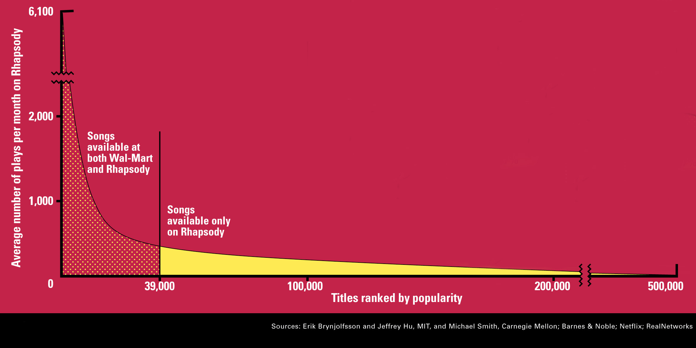
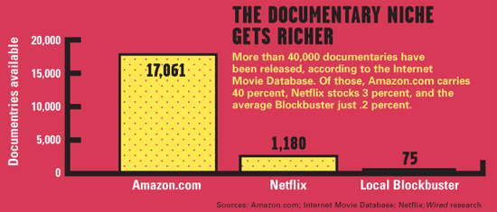
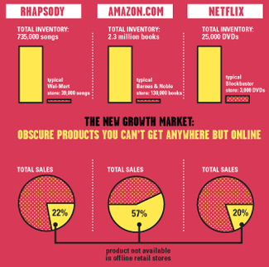
Sidenote: The Long Tail
Source: Chris Anderson (2004)

Slide 5
Formal Model
X = set of Customers
S = set of Items
Utility function u: X × S → R
R = set of ratings
R is a totally ordered set
e.g., 0-5 stars, real number in [0,1]

Slide 6
Utility Matrix
Avatar
LOTR
Matrix
Pirates
Alice
Bob
Carol
David

Slide 7
Key Problems
(1) Gathering “known” ratings for matrix
How to collect the data in the utility matrix
(2) Extrapolate unknown ratings from the known ones
Mainly interested in high unknown ratings
We are not interested in knowing what you don’t like but what you like
(3) Evaluating extrapolation methods
How to measure success/performance of recommendation methods

Slide 8
(1) Gathering Ratings
Explicit
Ask people to rate items
Doesn’t work well in practice – people can’t be bothered
Implicit
Learn ratings from user actions
E.g., purchase implies high rating
What about low ratings?

Slide 9
(2) Extrapolating Utilities
Key problem: Utility matrix U is sparse
Most people have not rated most items
Cold start:
New items have no ratings
New users have no history
Three approaches to recommender systems:
1) Content-based
2) Collaborative
3) Latent factor based
Today!

Slide 10
Collaborative Filtering
Harnessing quality judgments of other users

Slide 11
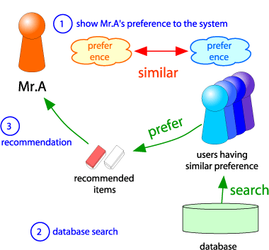
Collaborative Filtering
Consider user x
Find set N of other users whose ratings are “similar” to x’s ratings
Estimate x’s ratings based on ratings of users in N
x
N

Slide 12
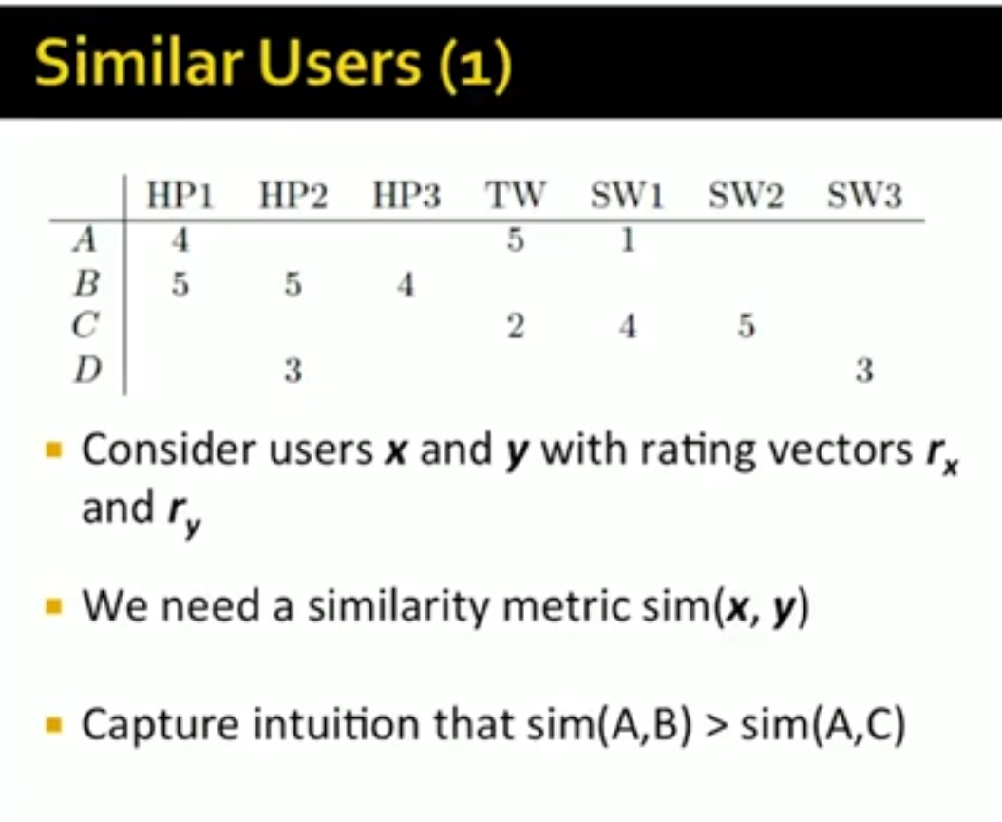

Slide 13
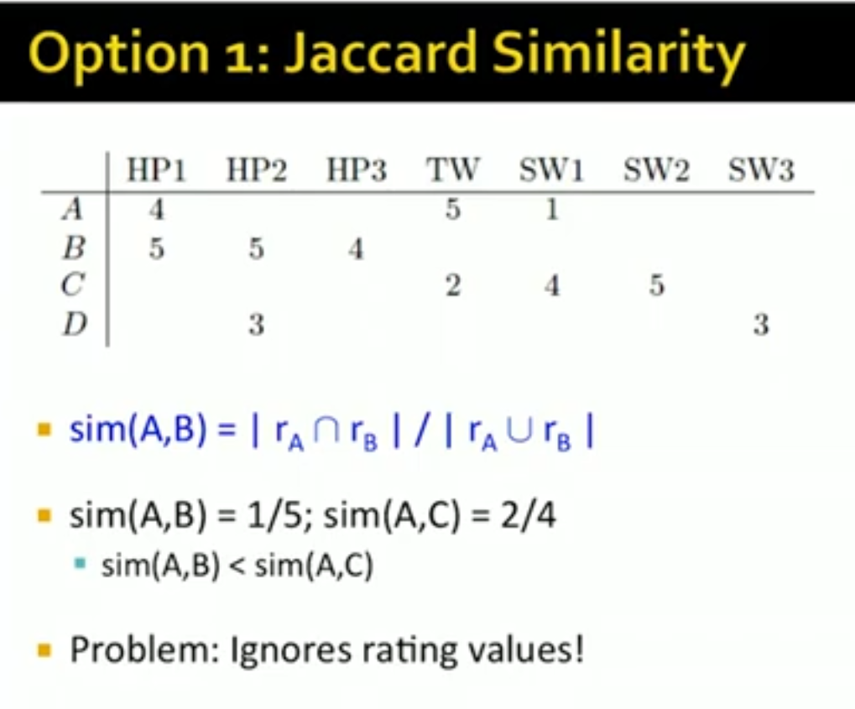

Slide 14
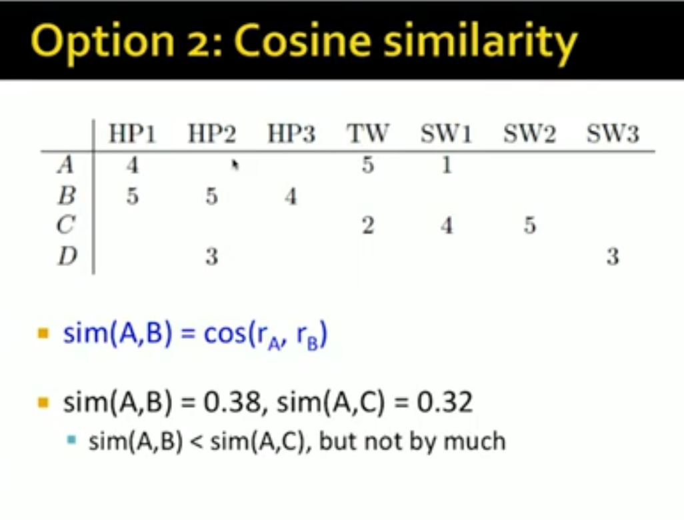

Slide 15
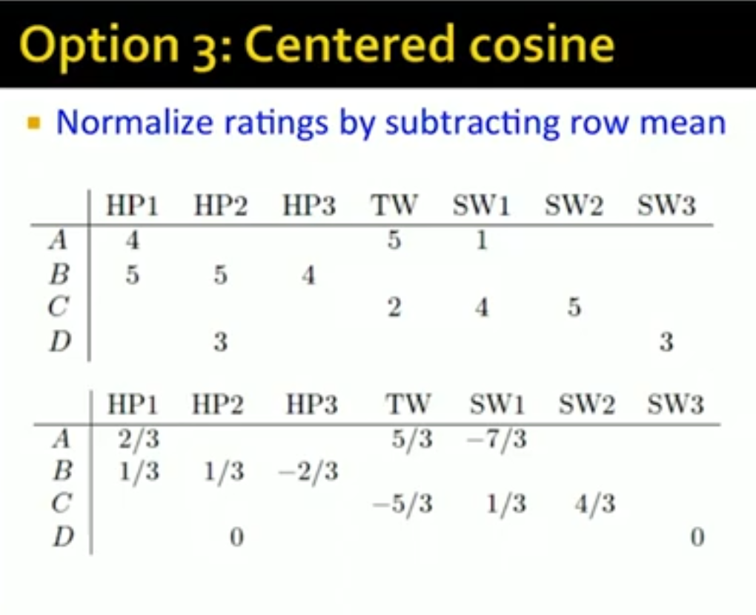

Slide 16
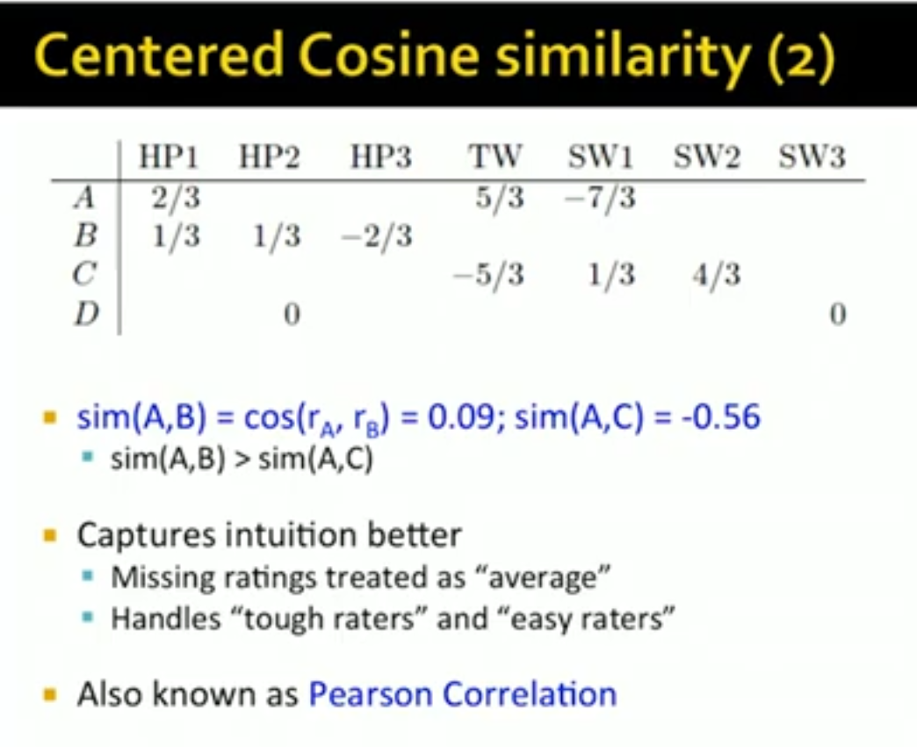

Slide 17
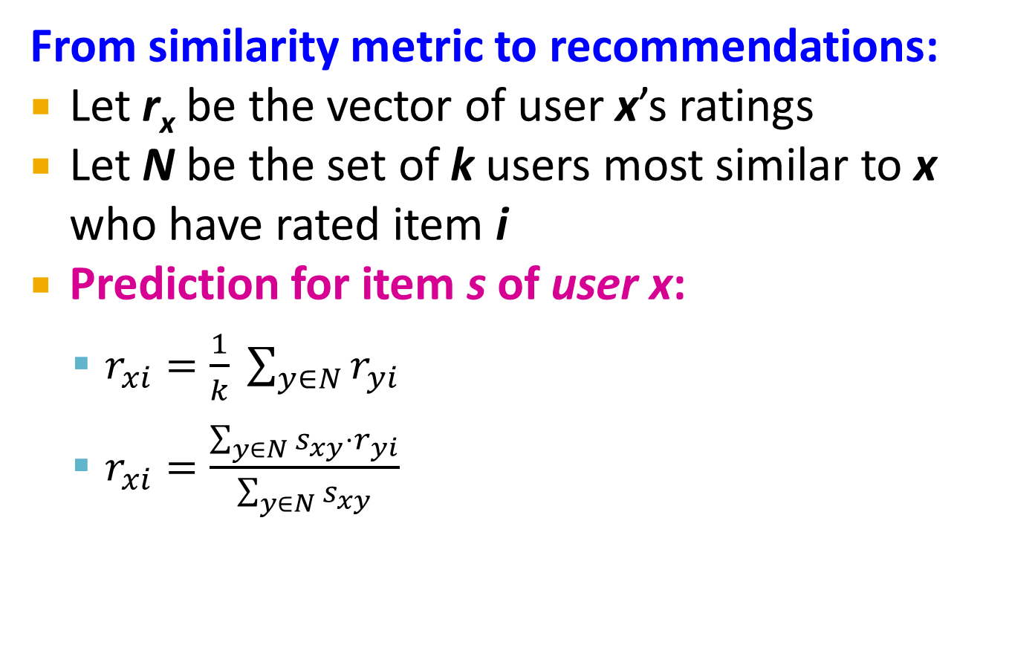
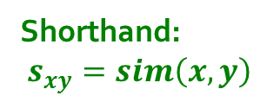
Rating Predictions
From similarity metric to recommendations:
Let r_{x} be the vector of user x’s ratings
Let N be the set of k users most similar to x who have rated item i
Prediction for item s of user x:
$r_{xi}=\frac{1}{k} \sum_{y∈N}{r_{yi}}$
$r_{xi}=\frac{\sum_{y∈N}{s_{xy}⋅r_{yi}}}{\sum_{y∈N}{s_{xy}}}$
Shorthand: $s_{xy}=sim\left(x,y\right)$

Slide 18
Item-Item Collaborative Filtering
So far: User-user collaborative filtering
Another view: Item-item
For item i, find other similar items
Estimate rating for item i based on ratings for similar items
Can use same similarity metrics and prediction functions as in user-user model
s_{ij}… similarity of items i and j
r_{xj}…rating of user u on item j
N(i;x)… set items rated by x similar to i

Slide 19
Item-Item CF (|N|=2)
users
12 | 11 | 10 | 9 | 8 | 7 | 6 | 5 | 4 | 3 | 2 | 1
 | 4 |  | 5 |  |  | 5 |  |  | 3 |  | 1 | 1
3 | 1 | 2 |  |  | 4 |  |  | 4 | 5 |  |  | 2
 | 5 | 3 | 4 |  | 3 |  | 2 | 1 |  | 4 | 2 | 3
 | 2 |  |  | 4 |  |  | 5 |  | 4 | 2 |  | 4
5 | 2 |  |  |  |  | 2 | 4 | 3 | 4 |  |  | 5
 | 4 |  |  | 2 |  |  | 3 |  | 3 |  | 1 | 6
movies
- unknown rating
- rating between 1 to 5

Slide 20
Item-Item CF (|N|=2)
users
12 | 11 | 10 | 9 | 8 | 7 | 6 | 5 | 4 | 3 | 2 | 1
 | 4 |  | 5 |  |  | 5 | ? |  | 3 |  | 1 | 1
3 | 1 | 2 |  |  | 4 |  |  | 4 | 5 |  |  | 2
 | 5 | 3 | 4 |  | 3 |  | 2 | 1 |  | 4 | 2 | 3
 | 2 |  |  | 4 |  |  | 5 |  | 4 | 2 |  | 4
5 | 2 |  |  |  |  | 2 | 4 | 3 | 4 |  |  | 5
 | 4 |  |  | 2 |  |  | 3 |  | 3 |  | 1 | 6
movies
- estimate rating of movie 1 by user 5

Slide 21
Item-Item CF (|N|=2)
users
12 | 11 | 10 | 9 | 8 | 7 | 6 | 5 | 4 | 3 | 2 | 1
 | 4 |  | 5 |  |  | 5 | ? |  | 3 |  | 1 | 1
3 | 1 | 2 |  |  | 4 |  |  | 4 | 5 |  |  | 2
 | 5 | 3 | 4 |  | 3 |  | 2 | 1 |  | 4 | 2 | 3
 | 2 |  |  | 4 |  |  | 5 |  | 4 | 2 |  | 4
5 | 2 |  |  |  |  | 2 | 4 | 3 | 4 |  |  | 5
 | 4 |  |  | 2 |  |  | 3 |  | 3 |  | 1 | 6
sim(1,m)
1.00
-0.18
0.41
-0.10
-0.31
0.59
movies
Neighbor selection: Identify movies similar to movie 1, rated by user 5
Here we use Pearson correlation as similarity:
1) Subtract mean rating m_{i} from each movie i m₁ = (1+3+5+5+4)/5 = 3.6 row 1: [-2.6, 0, -0.6, 0, 0, 1.4, 0, 0, 1.4, 0, 0.4, 0]
2) Compute cosine similarities between rows

Slide 22
Item-Item CF (|N|=2)
users
12 | 11 | 10 | 9 | 8 | 7 | 6 | 5 | 4 | 3 | 2 | 1
 | 4 |  | 5 |  |  | 5 | ? |  | 3 |  | 1 | 1
3 | 1 | 2 |  |  | 4 |  |  | 4 | 5 |  |  | 2
 | 5 | 3 | 4 |  | 3 |  | 2 | 1 |  | 4 | 2 | 3
 | 2 |  |  | 4 |  |  | 5 |  | 4 | 2 |  | 4
5 | 2 |  |  |  |  | 2 | 4 | 3 | 4 |  |  | 5
 | 4 |  |  | 2 |  |  | 3 |  | 3 |  | 1 | 6
sim(1,m)
1.00
-0.18
0.41
-0.10
-0.31
0.59
movies
Compute similarity weights: s_{1,3}=0.41, s_{1,6}=0.59

Slide 23
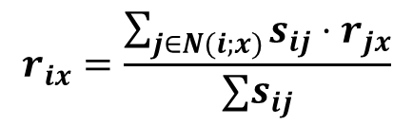
Item-Item CF (|N|=2)
users
12 | 11 | 10 | 9 | 8 | 7 | 6 | 5 | 4 | 3 | 2 | 1
 | 4 |  | 5 |  |  | 5 | 2.6 |  | 3 |  | 1 | 1
3 | 1 | 2 |  |  | 4 |  |  | 4 | 5 |  |  | 2
 | 5 | 3 | 4 |  | 3 |  | 2 | 1 |  | 4 | 2 | 3
 | 2 |  |  | 4 |  |  | 5 |  | 4 | 2 |  | 4
5 | 2 |  |  |  |  | 2 | 4 | 3 | 4 |  |  | 5
 | 4 |  |  | 2 |  |  | 3 |  | 3 |  | 1 | 6
movies
Predict by taking weighted average:
r_{1.5} = (0.41*2 + 0.59*3) / (0.41+0.59) = 2.6
$$r_{ix}=\frac{\sum_{j∈N(i;x)}{s_{ij}⋅r_{jx}}}{∑s_{ij}}$$

Slide 24

CF: Common Practice
Before:
Define similarity s_{ij} of items i and j
Select k nearest neighbors N(i; x)
Items most similar to i, that were rated by x
Estimate rating r_{xi} as the weighted average:
baseline estimate for r_{xi}
μ = overall mean movie rating
b_{x} = rating deviation of user x
= (avg. rating of user x) – μ
b_{i} = rating deviation of movie i
$$b_{xi}=μ+b_{x}+b_{i}$$

Slide 25
Item-Item vs. User-User
Avatar
LOTR
Matrix
Pirates
Alice
Bob
Carol
David
In practice, it has been observed that item-item often works better than user-user
Why? Items are simpler, users have multiple tastes
Notes:
There is a difference in the typical behavior of users and items, as it
pertains to similarity. Intuitively, items tend to be classifiable in simple
terms. For example, music tends to belong to a single genre. It is impossi-
ble, e.g., for a piece of music to be both 60’s rock and 1700’s baroque. On
the other hand, there are individuals who like both 60’s rock and 1700’s
baroque, and who buy examples of both types of music.
The consequence is that it is easier to discover items that are similar because they belong
to the same genre, than it is to detect that two users are similar because
they prefer one genre in common, while each also likes some genres that
the other doesn’t care for.

Slide 26
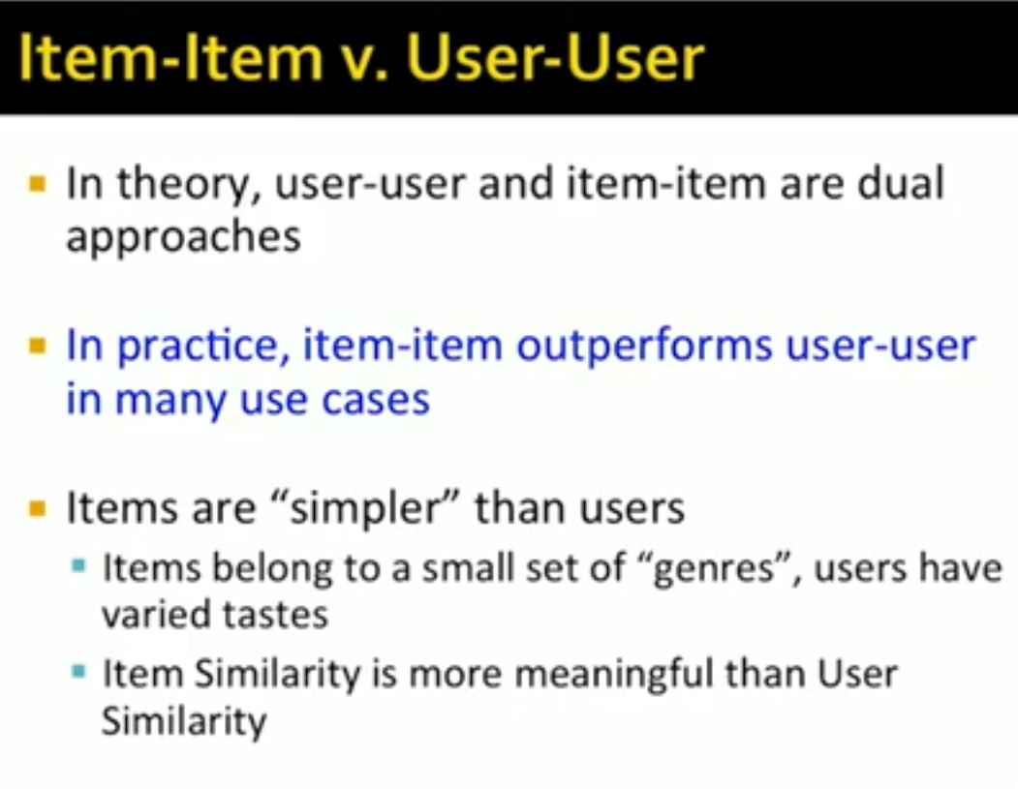

Slide 27
Pros/Cons of Collaborative Filtering
+ Works for any kind of item
No feature selection needed
- Cold Start:
Need enough users in the system to find a match
- Sparsity:
The user/ratings matrix is sparse
Hard to find users that have rated the same items
- First rater:
Cannot recommend an item that has not been previously rated
New items, Esoteric items
- Popularity bias:
Cannot recommend items to someone with unique taste
Tends to recommend popular items

Slide 28
Remarks & Practical Tips
- Evaluation
- Error metrics
- Complexity / Speed

Slide 29
Evaluation
movies
1 | 3 | 4
 | 3 | 5 |  |  | 5
 |  | 4 | 5 |  | 5
 |  | 3
 |  | 3
2 |  |  | 2 |  | 2
 |  |  |  | 5
 | 2 | 1 |  |  | 1
 | 3 |  |  | 3
1
users

Slide 30
Evaluation
movies
1 | 3 | 4
 | 3 | 5 |  |  | 5
 |  | 4 | 5 |  | 5
 |  | 3
 |  | 3
2 |  |  | ? |  | ?
 |  |  |  | ?
 | 2 | 1 |  |  | ?
 | 3 |  |  | ?
1
users
Test Data Set

Slide 31
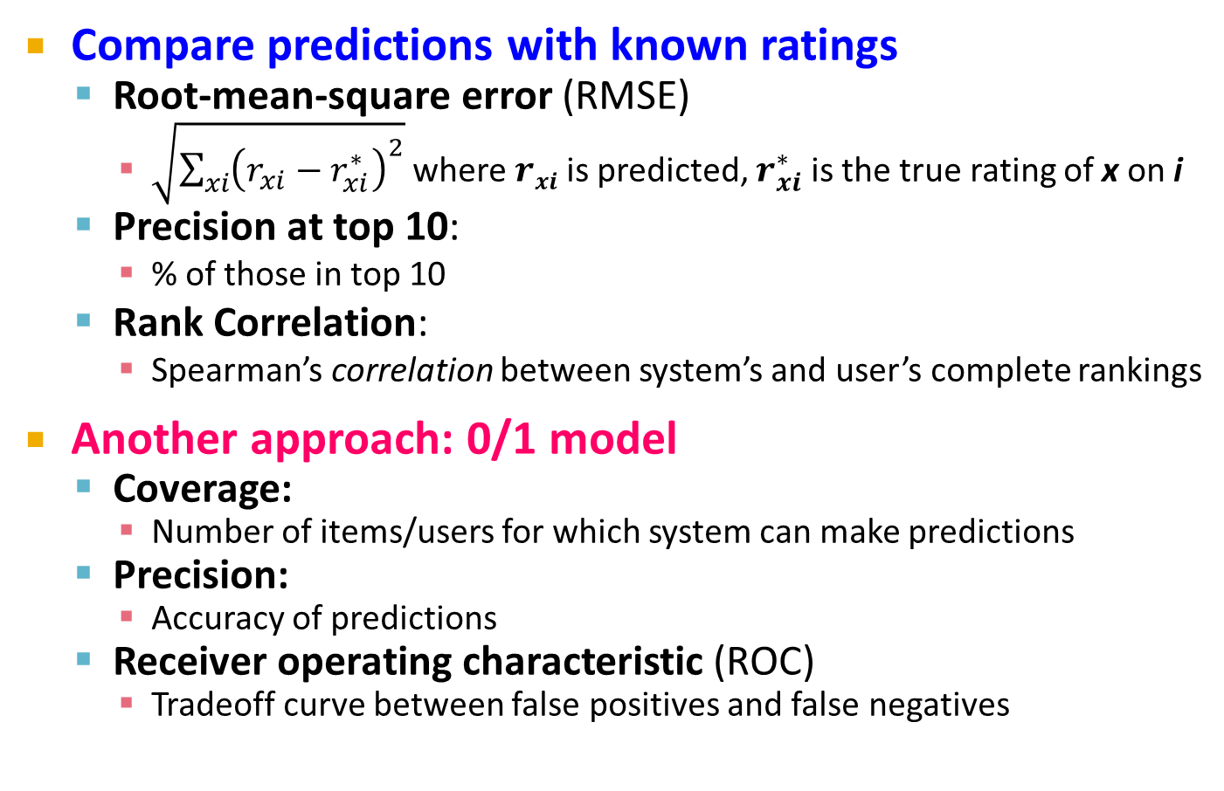
Evaluating Predictions
Compare predictions with known ratings
Root-mean-square error (RMSE)
$\sqrt{\sum_{xi}{{\left(r_{xi}−r_{xi}^{∗}\right)}^{2}}}$ where $rxi$ is predicted, $r_{xi}^{∗}$ is the true rating of x on i
Precision at top 10:
% of those in top 10
Rank Correlation:
Spearman’s correlation between system’s and user’s complete rankings
Another approach: 0/1 model
Coverage:
Number of items/users for which system can make predictions
Precision:
Accuracy of predictions
Receiver operating characteristic (ROC)
Tradeoff curve between false positives and false negatives

Slide 32
Problems with Error Measures
Narrow focus on accuracy sometimes misses the point
Prediction Diversity
Prediction Context
Order of predictions
In practice, we care only to predict high ratings:
RMSE might penalize a method that does well for high ratings and badly for others

Slide 33
Collaborative Filtering: Complexity
Expensive step is finding k most similar customers: O(|X|)
Too expensive to do at runtime
Could pre-compute
Naïve pre-computation takes time O(k ·|X|)
X … set of customers
We already know how to do this!
Near-neighbor search in high dimensions (LSH)
Clustering
Dimensionality reduction

Slide 34
Tip: Add Data
Leverage all the data
Don’t try to reduce data size in an effort to make fancy algorithms work
Simple methods on large data do best
Add more data
e.g., add IMDB data on genres
More data beats better algorithms
http://anand.typepad.com/datawocky/2008/03/more-data-usual.html

